Slide 1

PRIMARY BILIARY CIRRHOSIS
- A Look Into The Analytical Study
Akshay Amrit Aman Gupta Mohammed Arshan Khan Shivam Babbar
Prashantha Kooduvalli Shivshankarrao Rohit Krishnarao Umredkar Shruti Sudhakaran Nair

Slide 2
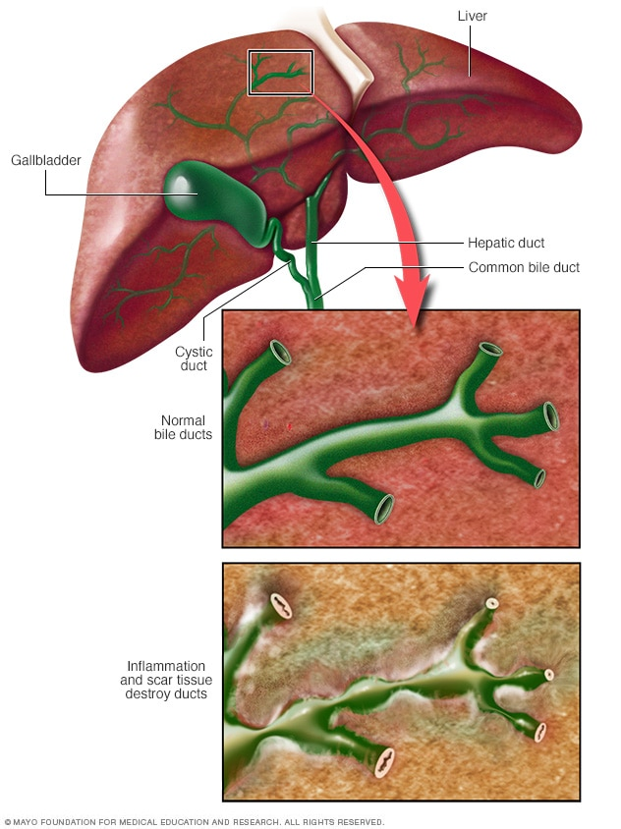
BACKGROUND
PBC is an auto-immune liver disorder, wherein the bile ducts are destroyed.
Key Features:
Prevalence: <= 4 in 100K
Peak Incidence: Around 50 years
Commonest in: Northern European
Least Common in: Africans
Male:Female :: 1:9

Slide 3
Bile accumulation
Cholestasis
Retained toxic materials
Damage of liver cells
Liver inflammation
Cirrhosis (Scarring of the liver)

Slide 4
EXPLANATION OF KEY VARIABLES
Case Number: Number of days between registration and the earlier of death, transplantation, or study analysis time in July, 1986.
Drug: 1 = D-penicillamine; 2 = Placebo
Sex: 0 = Male; 1 = Female
Presence of ascites: Ascites refers to the abnormal build-up of fluid in the abdomen, technically more than 25ml of fluid in the peritoneal cavity.
Presence of hepatomegaly: Enlargement of liver
Presence of spiders: Spider naevi is a case of swollen blood vessels found slightly beneath the skin surface, often containing a central red spot and reddish extensions which radiate outwards like a spider’s web.
Presence of edema: Edema is a medical word for swelling. In other words it means puffiness caused by excess fluid trapped in the body’s tissues.

Slide 5
Serum bilirubin: Bilirubin is a yellow compound formed by the breakdown of red blood cells in the body. The liver helps to excrete it.
Serum cholesterol: Serum cholesterol level is a measurement of certain elements in the blood, including the amount of high-and-low density lipo-protein cholesterol in a person’s blood.
Albumin: Albumin is a protein made by the liver. Albumin helps keep fluid in your bloodstream so it doesn’t leak into other tissues.
Urine copper: PBC can cause copper retention in the liver, the presence of which can be tested from the urine sample.
SGOT: It’s a blood test that’s part of the liver profile. A SGOT test evaluates how much of the liver enzyme is in the blood.
Triglycerides: It’s a lipid that can be measured in the blood.
Prothrombin time: PT is a blood test that measures how long it takes the blood to clot.

Slide 6
Visualizations

Slide 7
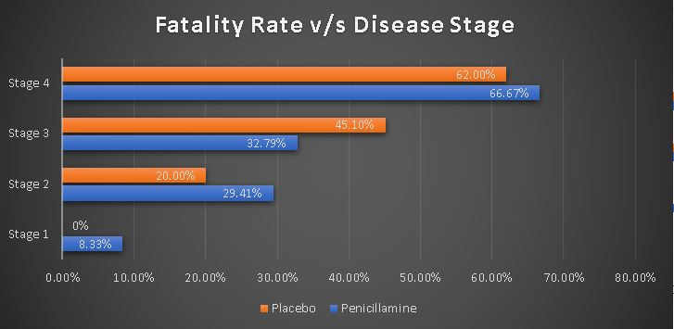

Slide 8
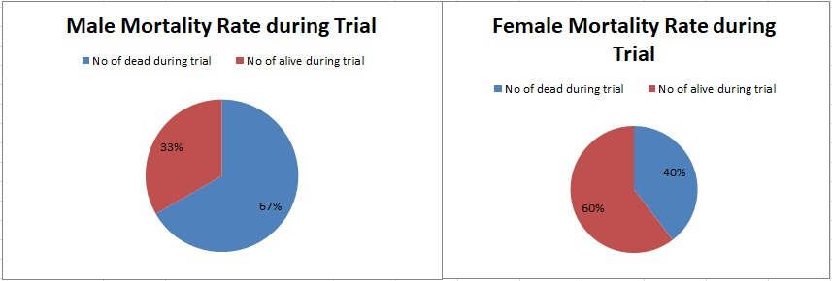

Slide 9
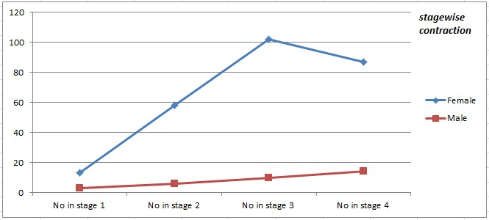

Slide 10
Kaplan Meier Test

Slide 11
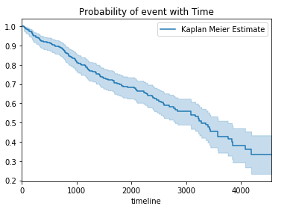
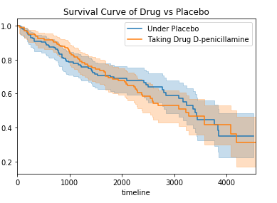
Top right: It shows the survival curve of Drug vs Placebo.
With the severity of adverse effects and continued progression of disease, D-penicillamine is not a clinically useful therapy in PBC.
Reference link: https://aasldpubs.onlinelibrary.wiley.com/doi/pdf/10.1002/hep.1840050613
Top left: It is the Kaplan-Meier curve.
It shows the survival analysis after using the Medication [Liver Tx]
The curve shows the probability of death over time.

Slide 12
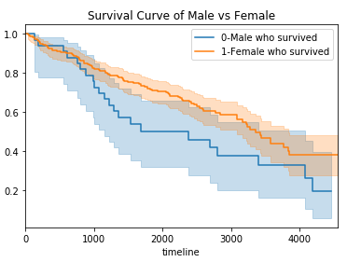
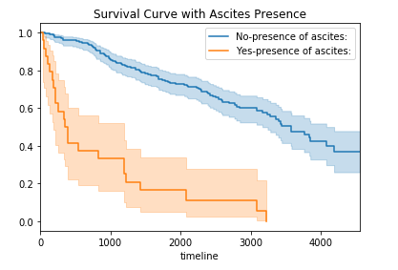
Top left: We observe the difference in the curves between males and females due to the data being highly skewed.
Top right: The above Survival curve shows the probability of death with reference to the presence of ascites.
Ascites is the main complication of cirrhosis,3 and the mean time period to its development is approximately 10 years.
Ascites is a landmark in the progression into the decompensated phase of cirrhosis and is associated with a poor prognosis and quality of life.
Mortality is estimated to be 50% in 2 years.

Slide 13
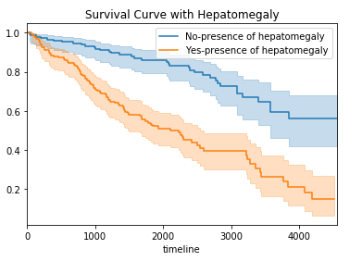
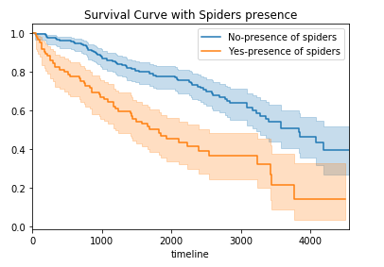
Top left: Survival curve with Hepatomegaly.
Most patients with alcohol-induced cirrhosis have hepatomegaly and/or splenomegaly.
Clinical presentation is similar to other forms of end-stage liver disease but may be accompanied by concurrent alcoholic hepatitis.
Top right: Survival curve with Spiders presence.
Spider angioma is a common presentation of liver cirrhosis.
It appears frequently in alcoholic cirrhotic or when liver function deteriorates and may be associated with oesophageal variceal bleeding.
However, the exact pathogenesis has been unclear.

Slide 14
Logrank Test

Slide 15
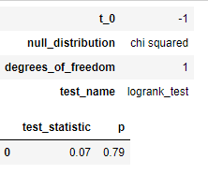
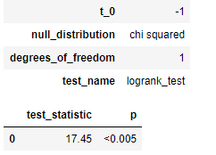
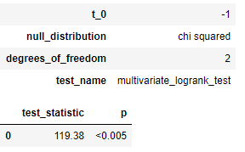
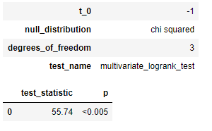
We describe here the logrank test, the most popular method of comparing the survival of groups, which takes the whole follow up period into account. It has the considerable advantage that it does not require us to know anything about the shape of the survival curve or the distribution of survival times.
The logrank test is used to test the null hypothesis that there is no difference between the populations in the probability of an event (here a death) at any time point. The analysis is based on the times of events (here deaths). For each such time we calculate the observed number of deaths in each group and the number expected if there were in reality no difference between the groups.
Drug: 1 = D-penicillamine;
0 = Placebo
Sex: 0 = Male; 1 = Female
Presence of Edema
Histologic stage of Disease

Slide 16
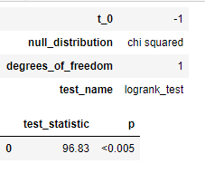
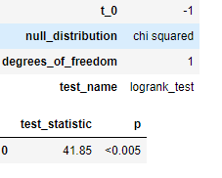
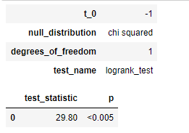
Presence of Ascites
Presence of Hepatomegaly
Presence of Spiders
Ascites is the main complication of cirrhosis and the mean time period to its development is approximately 10 years.
Most patients with alcohol-induced cirrhosis have hepatomegaly and/or splenomegaly. Clinical presentation is similar to other forms of end-stage liver disease but may be accompanied by concurrent alcoholic hepatitis.
It appears frequently in alcoholic cirrhotics or when liver function deteriorates and may be associated with oesophageal variceal bleeding. However, the exact pathogenesis has been unclear.

Slide 17
Cox Regression

Slide 18

Why Cox regression?
Cox’s can analyze multiple risk factors for survival, unlike other methods (e.g. Kaplan-Meier analysis) which can only handle one.
Cox’s regression also tackles the problem of participant heterogeneity.
Cox PH model, hazard ratio comparing exposed to unexposed patients at any time is given by the constant value e to the b “hat,” which does not vary over time.

Slide 19
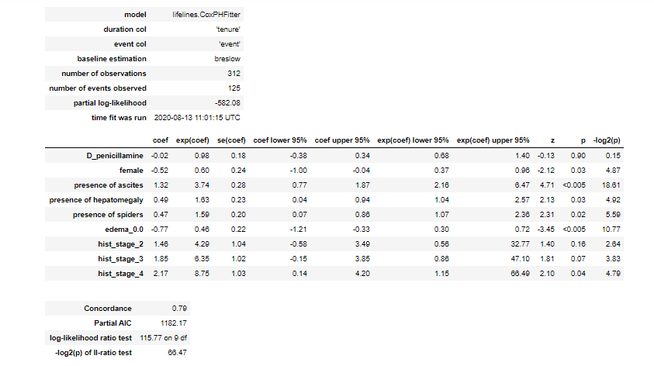

Slide 20
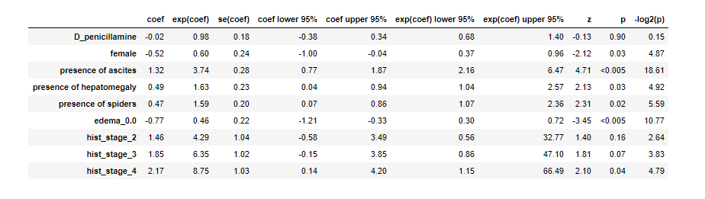

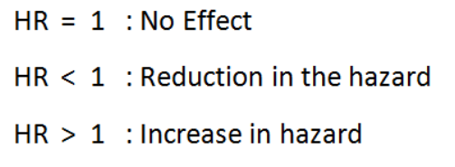
Female, presence of ascites', 'presence of hepatomegaly', 'presence of spiders', 'edema_0.0', 'hist_stage_3', 'hist_stage_4‘ having p value <0.05 indicating a strong relationship between the patients’ sex and decreased risk of death.
HR (Hazard Ratio) = exp(bi)

Slide 21
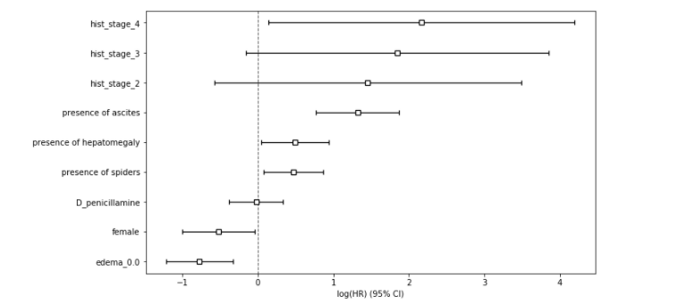
Female, presence of ascites', 'presence of hepatomegaly', 'presence of spiders', 'edema_0.0', ‘D-penicillamine’ gives more precise estimate of the hazard ratio.

Slide 22

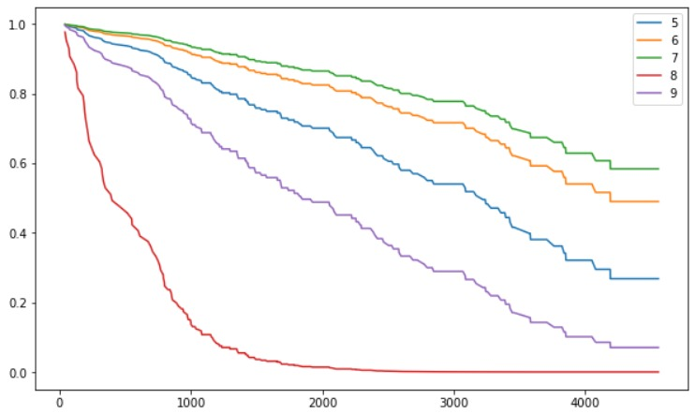
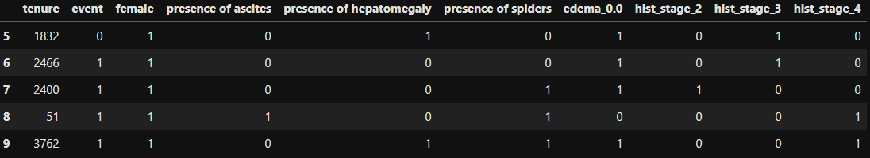
C must be between 0 and 1, with 1 representing perfect agreement between model and observation and 0.5 representing random guesses In survival data, C = 0.6-0.8 is pretty common.

Slide 23
II Thank You II

